Slide 1
Slide 1
Emotion Based Music Player
Presented By
Guided By
SATYAM GUPTA
Dr. Abhishek Prabhakar
Kapil Kumar Pandey
RAJESH CHAUDHARY
Notes:
These can be changed to reflect your school’s specific rules.

Slide 2
Introduction
Current research in the field of music psychology has shown that music induces a clear emotional response in its listeners . Musical preferences have been demonstrated to be highly correlated with personality traits and moods. The meter, timber, rhythm and pitch of music are managed in areas of the brain that deal with emotions and mood. Current research in emotion based music player system focuses on two main aspects, lyrics and audio features.

Slide 3
Emotion Basics
This music player provides songs , based on various classes of emotions and moods.
Facial expression is the most ancient and natural way of expressing feeling, emotions and mood and it’s algorithm requires less computational, time and cost.
The facial expressions categorize in six different emotion.
Anger, Neutral, Surprise, Sad, Fear, Happy.

Slide 4
Slide 3
Keywords
Recognition, Artificial Intelligence, OpenCV , Web browser, Keras.models, Numpy, Tensorflow ,Flask Libraries.
Technologies are Used
Pycharm , Webcam , Face Recognition Algorithms, Youtube Database.

Slide 5
Accuracy
The system has also been able to grab the new images of the user and appropriately update its classifier and training dataset.
The system was designed using the facial landmarks scheme and is tested under various scenarios for the result that would be obtained.
It is seen that the classifier has an accuracy of more than 80 percent for most of the test cases, which is pretty good accuracy in terms of emotion classification.
It can also be seen that the classifier can accurately predict the expression of the user in a real-time scenario when tested live for a user.

Slide 6
Con…
Instructions Explained to the User. In this scenario the users were given instructions as to what is to be done to perform the prediction of the emotion expressed which provided the following results.
Sometimes in cases where the inner emotion is sad and facial expression is happy it resulted in a fail case. The values are given in Table.

Slide 7
Result Analysis
Instructions Explained to the User
User | Emotion | Facial Expression | Accuracy
1 | Happy | Happy | 100
2 | Sad | Happy | 0
3 | Happy | Happy | 100
4 | Sad | Sad | 100

Slide 8
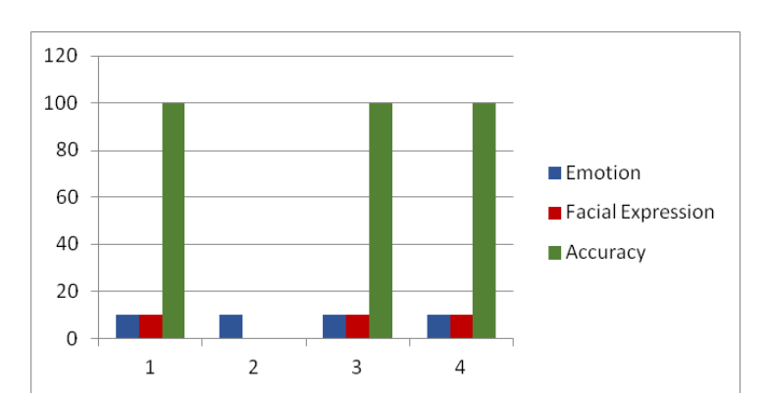
Con…

Slide 9
Con…
Instructions not given to the User. In this scenario the users were not given any instructions as to what is to be do and thus the inner emotions or the emotions recognized failed.
There were also cases where in the emotion matched with the facial expressions of the user. The values are given in Table.

Slide 10
Con…
Instructions not given to the User
User | Emotion | Facial Expression | Accuracy
1 | Happy | Sad | 0
2 | Sad | Happy | 0
3 | Sad | Sad | 100
4 | Happy | Sad | 0

Slide 11
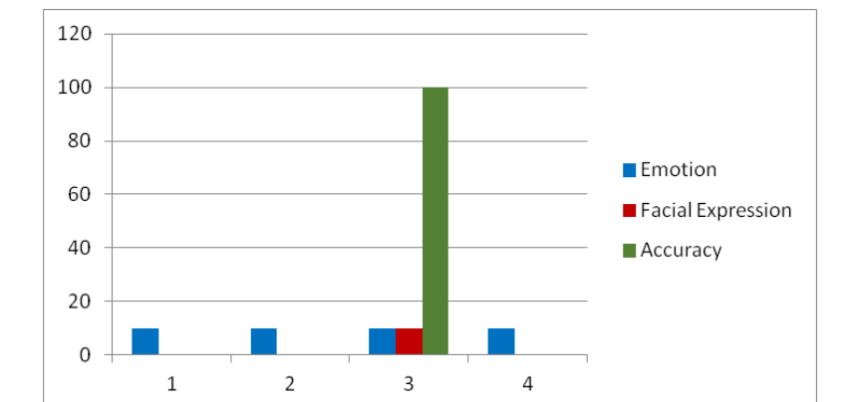
Con…

Slide 12
Requirement
1.Track user emotion
2.Recommend by Sorting playlist based on user’s current emotion.
3.Sort songs by 2 factors
Relevancy to User Preference
Effect on User Emotion

Slide 13
Emotion Extraction Module
Done by the analysis on images , image of a user is captured using a webcam or it can be accessed from the stored image in the hard disk.
This acquired image undergoes image enhancement in the form of tone mapping in order to restore the original contrast of the image.
Converted into binary image format.

Slide 14
Related research
Emotion recognition by appearance-based feature extraction and Geometric based feature extraction.
An accurate and efficient statistical based approach for analyzing extracted facial expression feature.

Slide 15
Slide 5
Related Work
Describes the advantages of using OpenCV, especially the Ad boost algorithm, in the process of face recognition. Detecting and recognition of face in complicated color images can be achieved using a combination of a particular algorithm with AdaBoost algorithm. It also talks about the disadvantages of using a timer in face detection.
The faces distinguished utilizing channels in OpenCV and changed over to Greyscale.
The picture to be prepared was acquired from a web camera or the hard Circle itself.
Notes:
*Change this verbiage to the language your school uses.

Slide 16
Slide 6
SYSTEM ARCHITECHURE
Face Input Image
Image processing
SVM
Classifier
Emotion
Recognizer
Play Music according to emotion
Youtube
Database
Feature Extraction

Slide 17
Slide 7
CONCLUSION AND FUTURE ENHANCEMENT
A simple system is proposed here for the music player using face emotion recognition. It’s play music by extracting different facial emotion of a person: Happy, Anger, Surprise, Neutral, Fear, Sad.

